Slide 1


https://www.thepeakmagazine.com.sg/ October 11, 2019
Workshop: Colorimetry

Slide 2
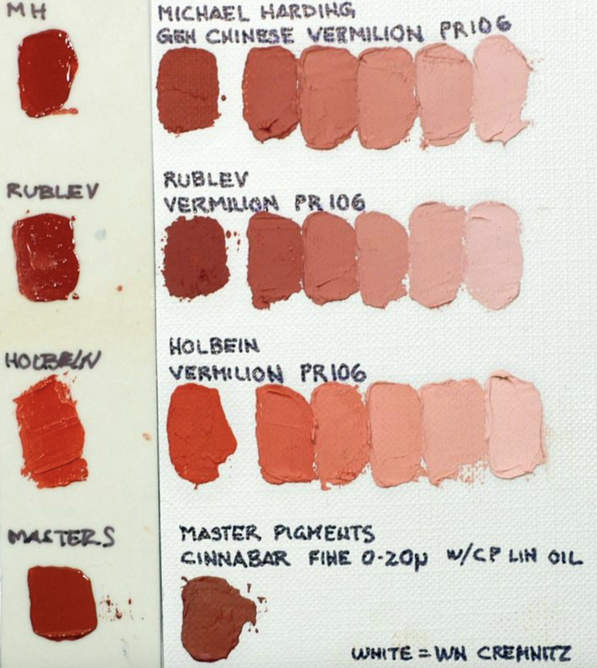
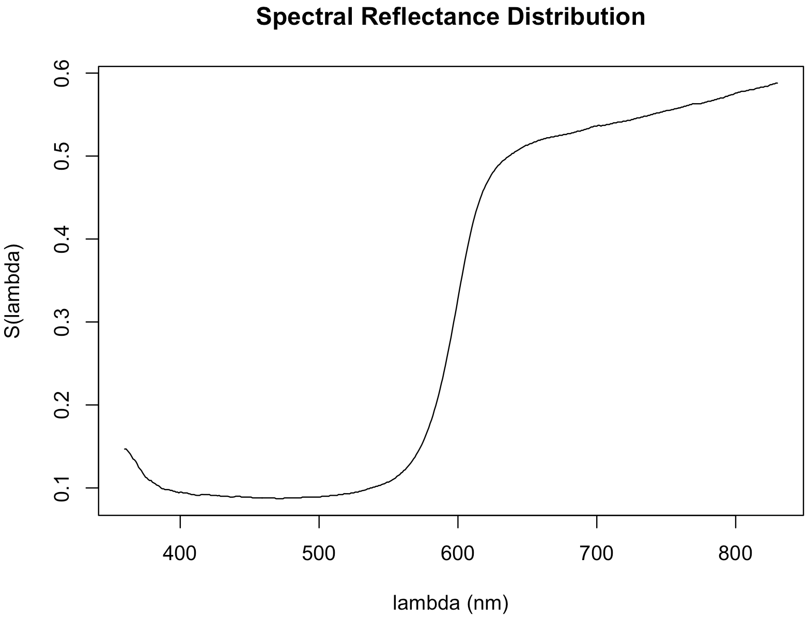
Historical Pigments on Cardboard
Fiber Optics Reflectance Spectroscopy (FORS) can be used to help ID pigments in artworks
Cosentino collected a FORS reference database of reflectance spectra for numerous pigments/binders on watercolor paper (http://www.e-conservation.org/issue-2/36-FORS-spectral-database)

Slide 3
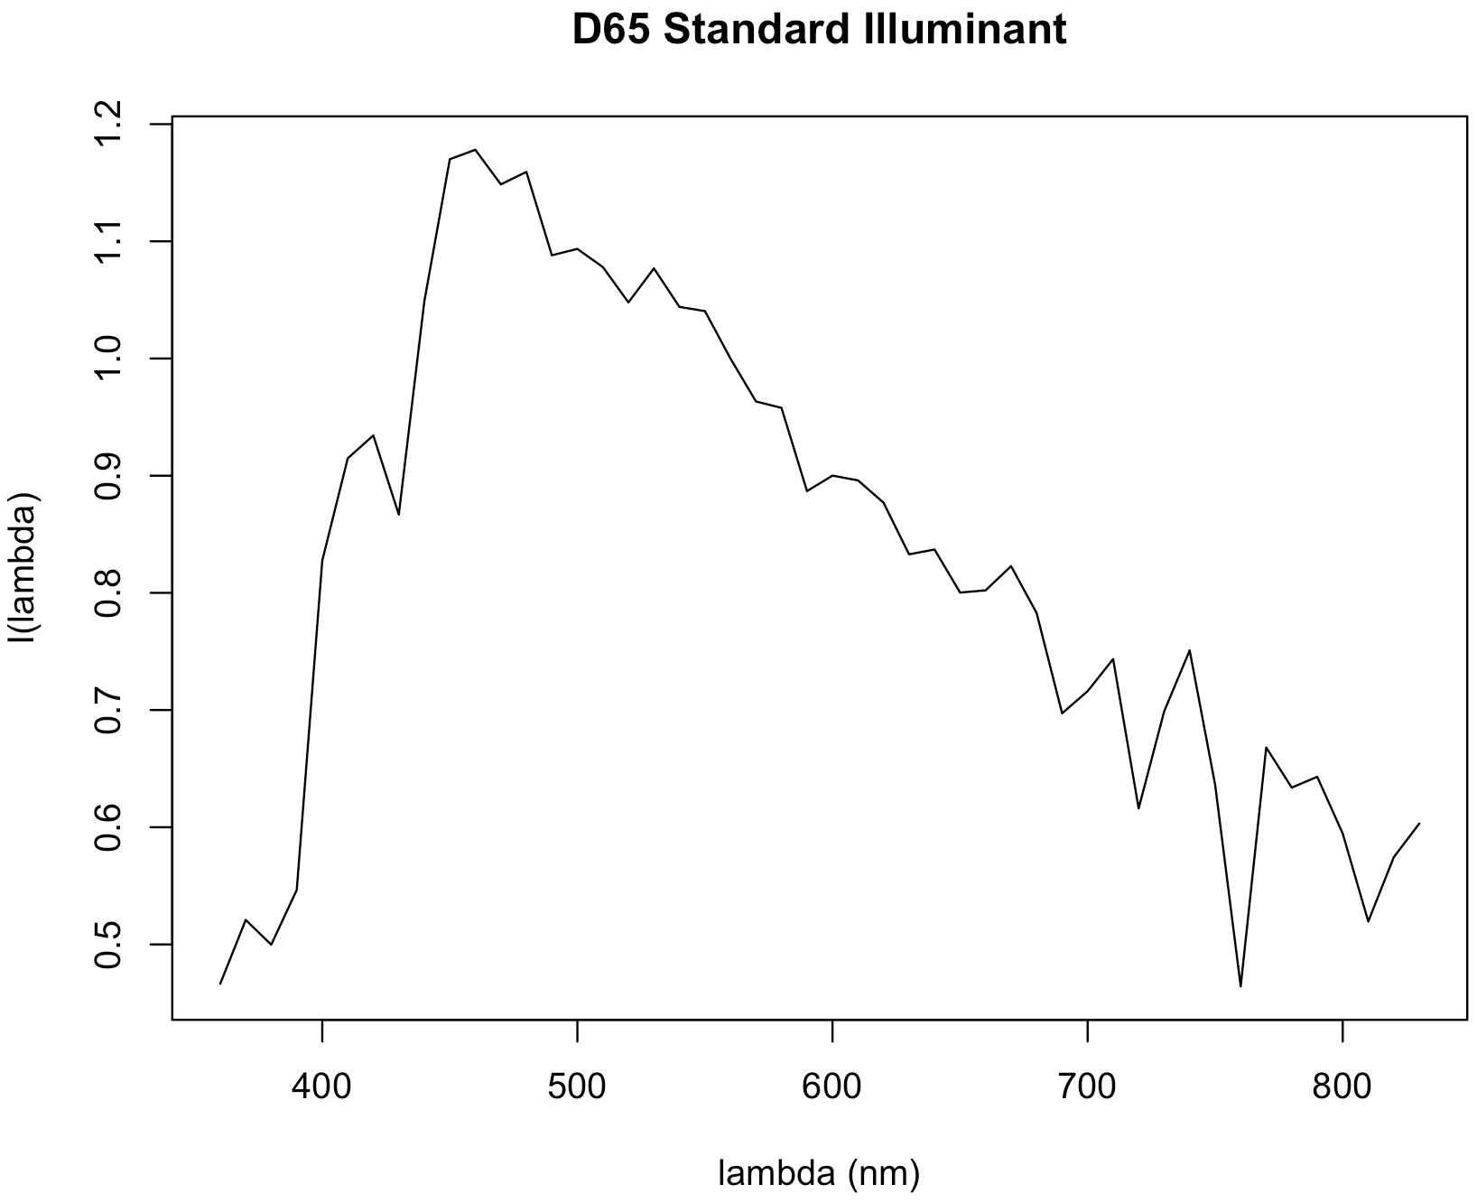
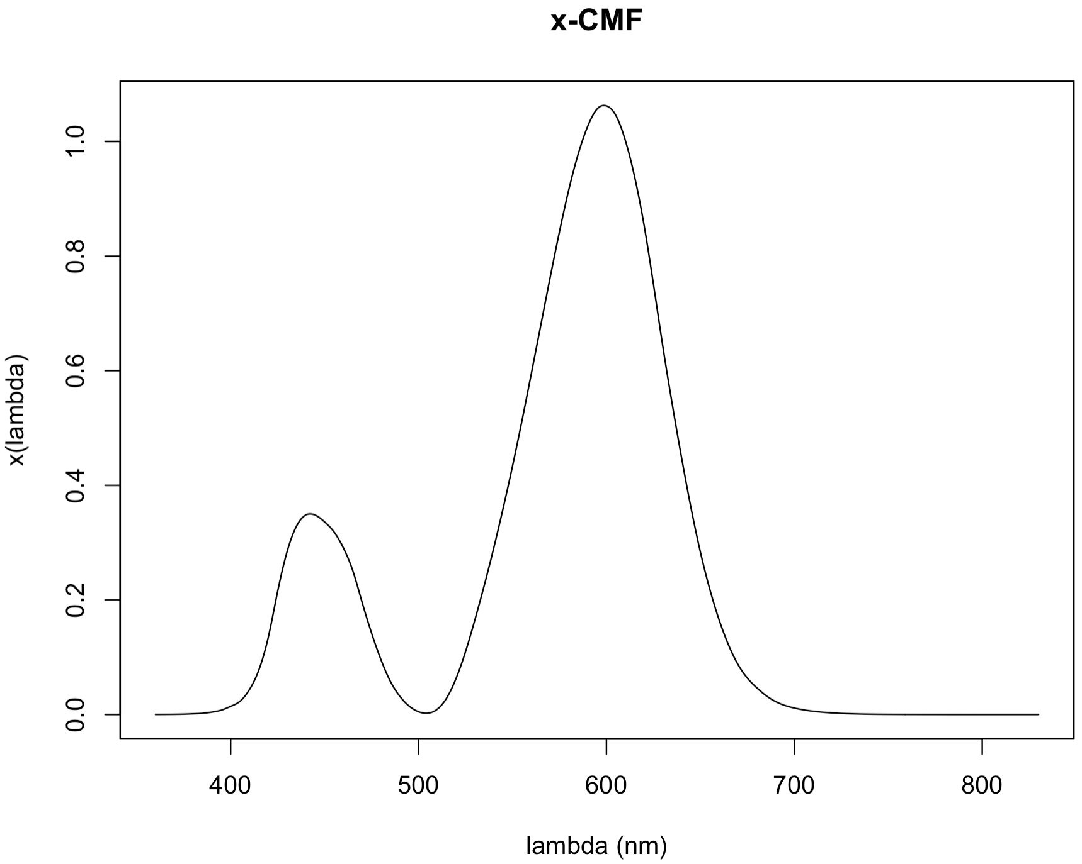
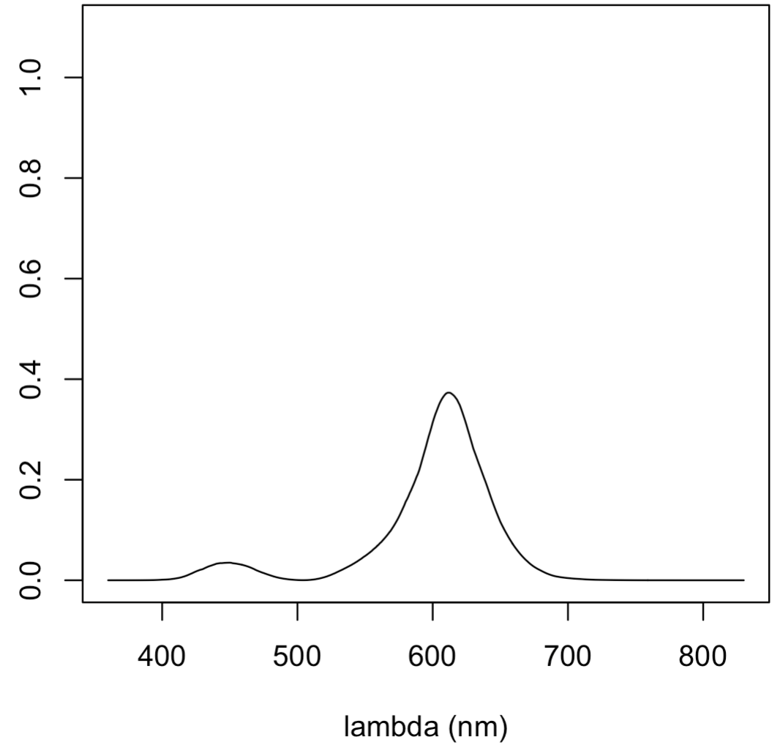
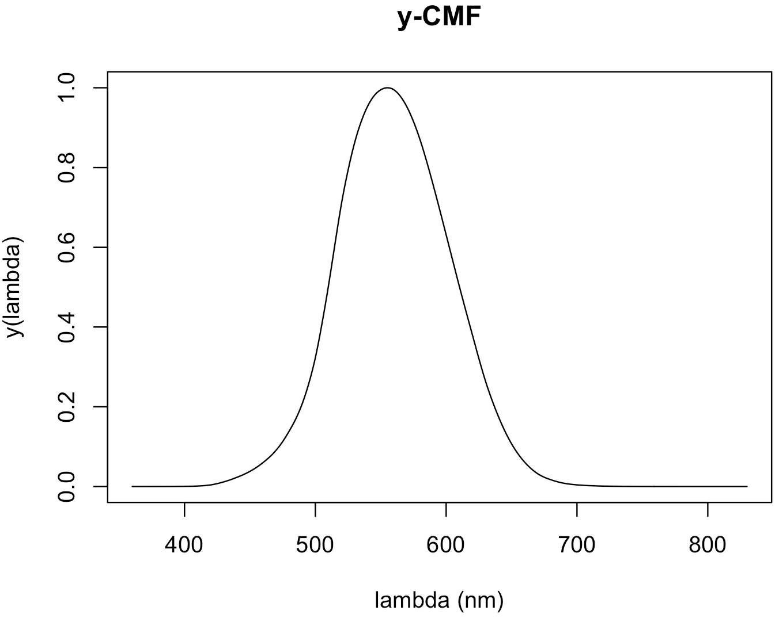
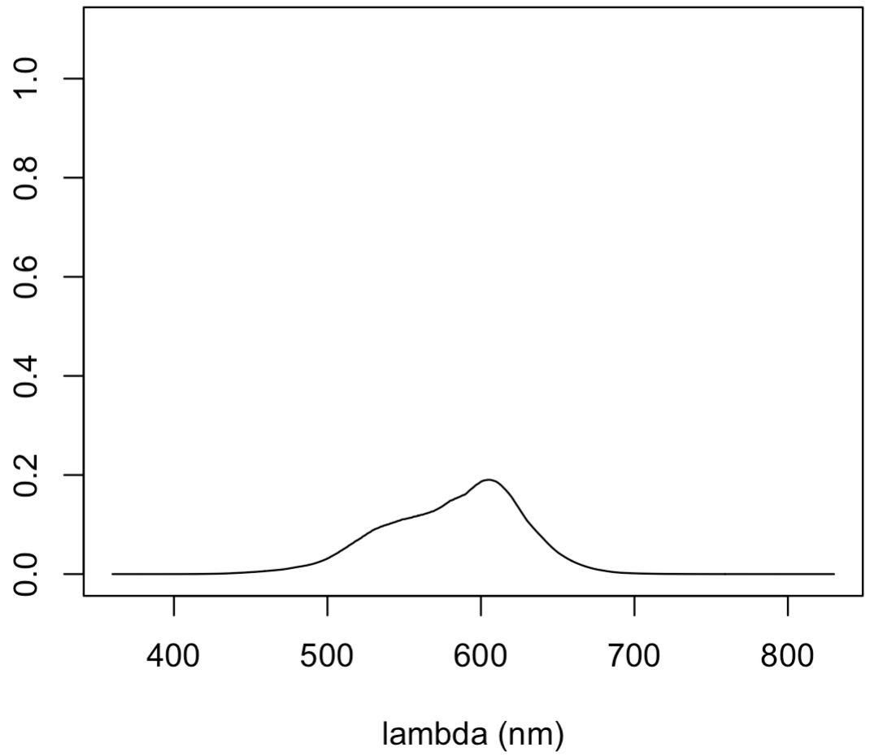
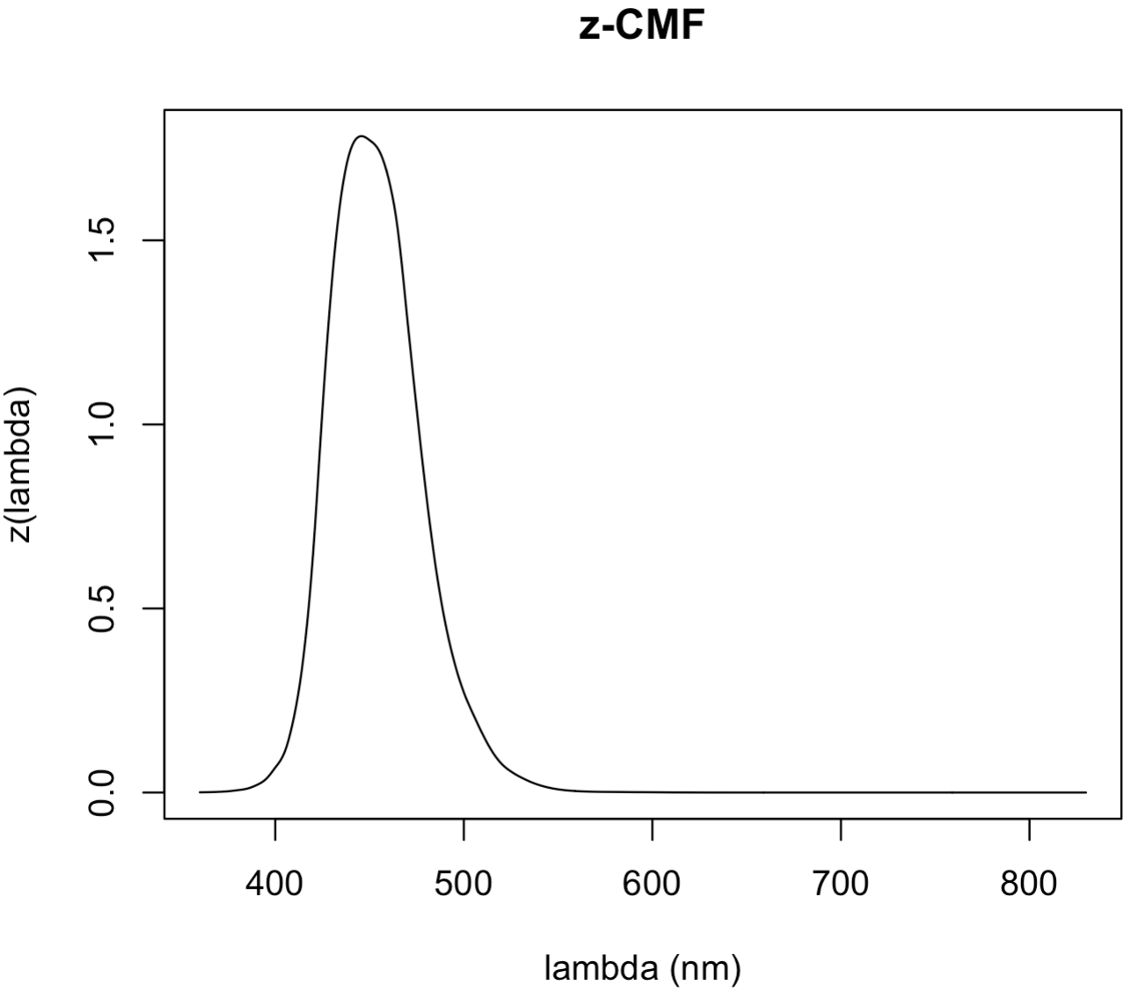
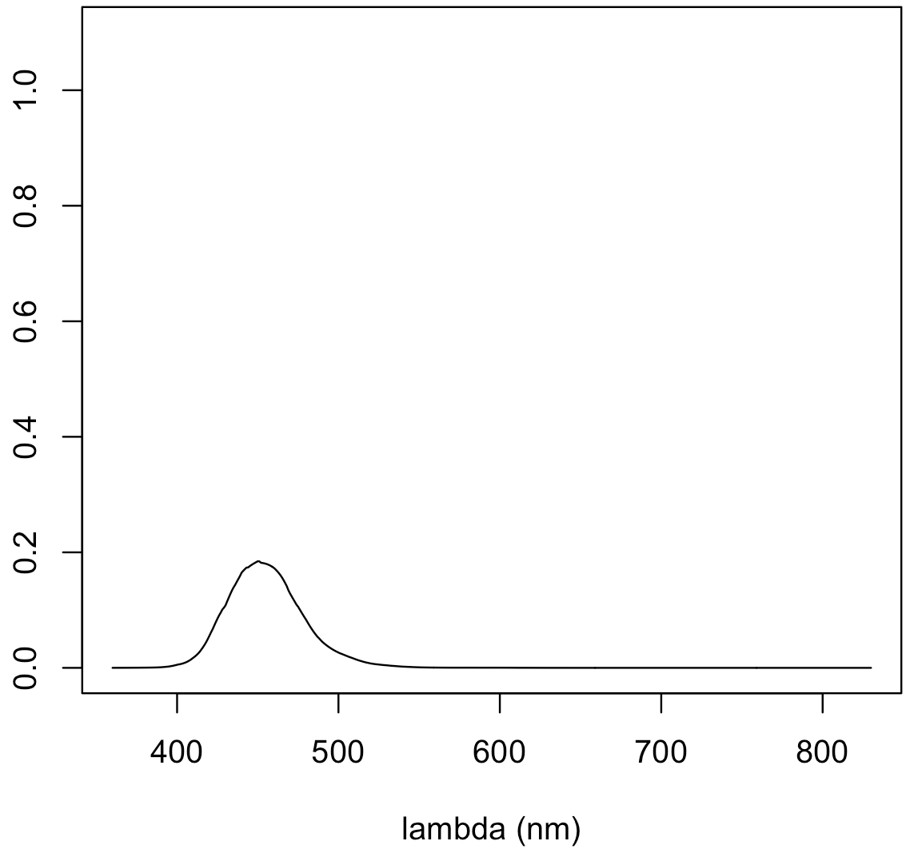
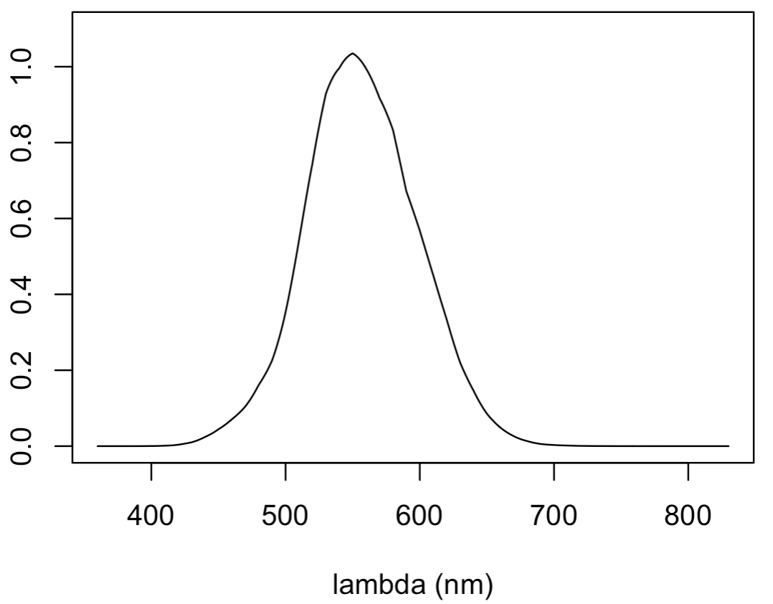
Integrated color response

Slide 4
Computing color coordinates
Since we have a decent amount of data and it’s all discrete, we can reasonably approximate the integrals as sums:

Slide 5
Color Quantification Control Script
#library(colorscience)
library(che302r)
dat <- read.csv("https://npetraco.github.io/CHE302/Laboratories/Lab7/color_lab_data.csv",header = T)
attach(dat)
colnames(dat)
S <- unk.SRD2
I <- illuminant.SPD
d.lammbda <- 1 # resolution is 1nm
N <- sum(y.cmf * I * d.lammbda)
X <- (1/N) * sum(x.cmf * S * I * d.lammbda)
Y <- (1/N) * sum(y.cmf * S * I * d.lammbda)
Z <- (1/N) * sum(z.cmf * S * I * d.lammbda)
XYZ <- c(X,Y,Z)
XYZ
x <- X/sum(c(X,Y,Z))
y <- Y/sum(c(X,Y,Z))
xyY <- c(x,y,Y*100)
xyY
# Convert to closest sRGB and plot swatch:
#vec2hex <- function(a.vec){paste(c("#",as.character(as.hexmode(a.vec))), collapse = "")}
XYZ2sRGB(XYZ)
plot(1, pch=16, cex=12, col=XYZ2sRGB(XYZ)$hex)
detach(dat)

Slide 6
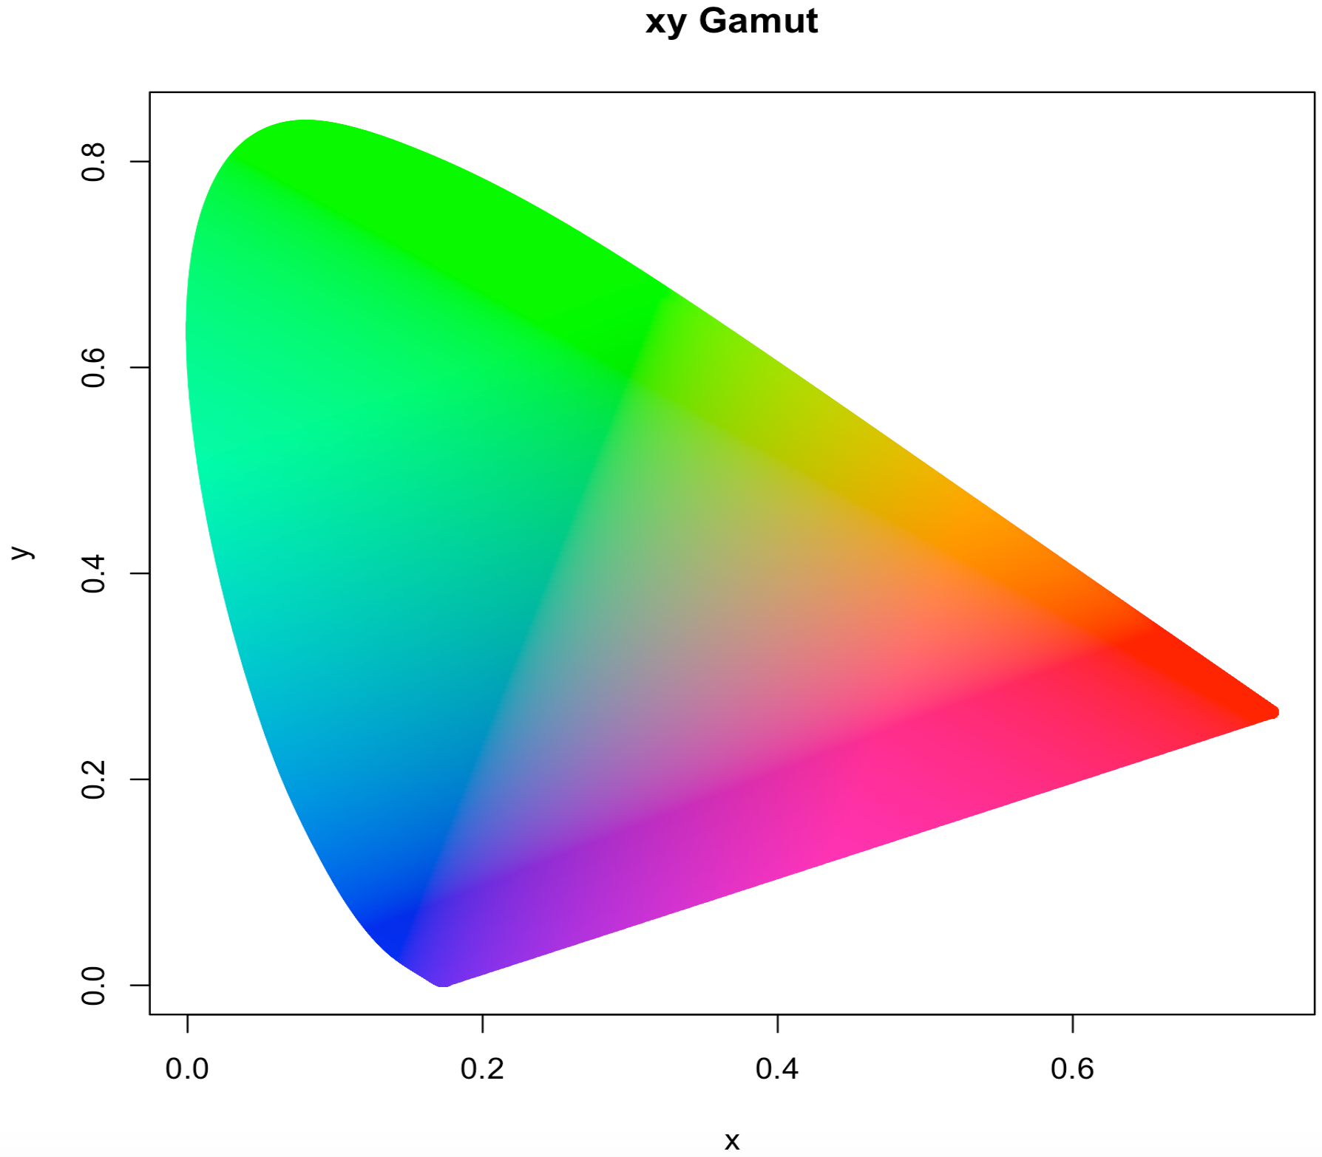
Enrichment:(Approximate) xy-Chromaticity Gamut

Slide 7
(Approximate) xy Chromaticity Gamut
library(colorscience)
library(geometry)
data("cccie31")
lam <- cccie31[,1]
xfd <- cccie31[,2]
yfd <- cccie31[,3]
# x and y color matching functions:
xf <- splinefun(lam,xfd)
yf <- splinefun(lam,yfd)
# make a grid in xy-chromaticity space:
pxcc <- seq(0,max(xfd), length.out=1000)
pycc <- seq(0,max(yfd), length.out=1000)
cs.grd <- as.matrix(expand.grid(pxcc,pycc))
# The Gamut forms a convex hull. Generate a high-resolution Gamut edge (the convex hull)
# and determine which chromaticity points are in it:
lambda <- seq(from=min(lam), to=max(lam), length.out=5000)
p <- cbind(xf(lambda),yf(lambda))
ch <- convhulln(p)
pts.in.gamutQ <- inhulln(ch, cs.grd)
xygp <- cs.grd[which(pts.in.gamutQ==T),]
xygp2 <- rbind(p, xygp)
# Determine the closest sRGB color to the xy coordinates in the hull
xyz <- cbind(xygp2, 1-rowSums(xygp2))
hcc <- sapply(1:nrow(xyz), function(xxx){paste(c("#",as.character(as.hexmode(xyz2srgb(xyz[xxx,])$sRGB))), collapse = "")})
plot(xygp2, col=hcc, pch=16, main="xy Gamut", xlab="x", ylab="y”)

